Slide 1
Error Analysis
Significant Figures and Error Propagation

Slide 2
Precision vs Accuracy
Precision: how small the random error is.
Accuracy: how close the measured quantity is to the actual value. High accuracy means small systematic error.

Slide 3
Random Error & Systematic Error
Random Error:
Error due to uncontrollable fluctuations
Examples: human reaction time, fluctuations in surrounding temperature, pressure influencing measuring apparatus
Systematic Error:
Unknown defects or inadequate calibration of instruments.
Can in principle be eliminated completely
Examples: A ruler that has one end cut off so all measurements of length is off by the same amount.

Slide 4
Instrument Uncertainty
Every instrument has its limit, or resolution, beyond which one cannot reliably measure a quantity.
We will talk about how to find the instrument uncertainty for digital and graduated instrument.
In most cases, however, the instrument is merely the lower bound on the uncertainty. Most measurements are dominated by random error (find by statistical analysis on multiple measurement, see below) so instrument uncertainty is not often used in the error calculation.
Rule of thumb: Only use instrument uncertainty if only one measurement is possible, or if the random error turns out to be smaller than the instrument uncertainty (highly unlikely).

Slide 5
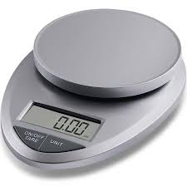
Instrument Uncertainty (Digital Instrument)
For a digital instrument, the last digit is the uncertainty. For example 2.34g means (2.34±0.01)g.

Slide 6
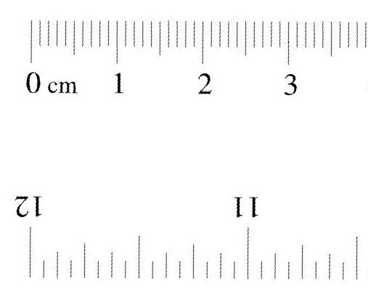
Instrument Uncertainty (Graduated Instrument )
Optimistic:
Try to guess to one digit beyond the smallest scale
A typical ruler is graduated to 1mm, read length to 0.1mm (thus the error is ±0.1mm)
Conservative
Set uncertainty to half of the smallest scale
A typical ruler is graduated to 1mm, read length to 0.5mm (thus the error is ±0.5mm)

Slide 7
Instrument Uncertainty (Judgment call)
Sometimes you may want to increase the uncertainty beyond even the conservative instrument uncertainty if the measurement was not carried out in ideal situations.
For example, in measuring the diameter of a tennis ball with a ruler, it is difficult to say if your ruler is really lined up with the diameter, so it does not make sense to use 0.5mm as the uncertainty.
If you can make only one measurement, the uncertainty to use is a judgment call.
In general, however, one should use multiple measurements and use the statistical analysis below (using standard deviation) to find the uncertainty.

Slide 8
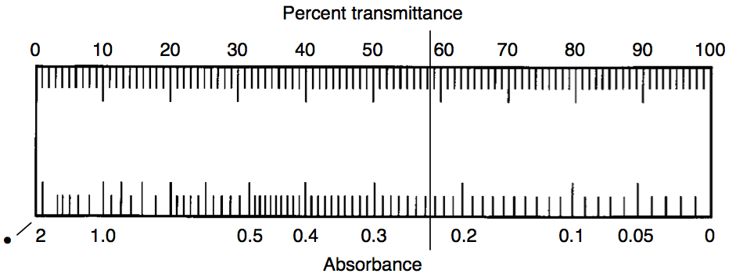
Examples
Absorbance: 0.236±0.001 (optimistic choice)
Absorbance: 0.240±0.005 (conservative choice)
Transmittance: 58.0±0.5 (conservative: scale for transmittance too small to see clearly)

Slide 9
Mean (average)
Repeated measurements:
Common mistake:
Too many digits
Usually, the mean has only slightly better precision, so keep to at most one higher significant figure. The mean above should be either 3.3 or 3.
We will learn how to find the uncertainty below.

Slide 10
(Sample) Standard Deviation σ
The smaller the standard deviation, the more better are your data.

Slide 11
Relation to Random Uncertainty

Slide 12
Example
Find the σ of the following measurement of length x:
11.3cm, 11.7cm, 12.0cm, 11.8cm

Slide 13
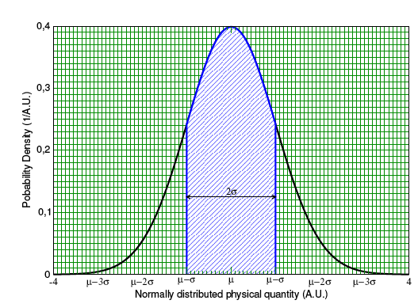
Standard deviation
68% of probability lying within a width of 2σ.

Slide 14
Using Excel
x
11.35
10.41
11.30
11.92
11.59
10.42
11.82
Count | Mean of x | Error of x | Error of mean of x
7 | 11.25744097 | 0.618048218 | 0.233600269
"=COUNT(…)" | "=AVERAGE(…)" | "=STDEV.S(…)" | "=error/SQRT(count)"

Slide 15
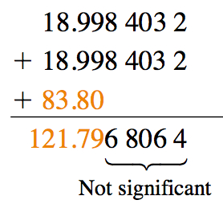
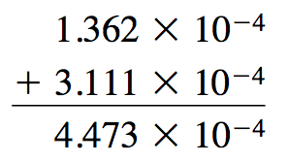
Arithmetic Addition and Subtraction

Slide 16
Scientific Notation
Express numbers to the same exponents during addition and subtraction.

Slide 17
Arithmetic Multiplication and Division
No need to express numbers to the same exponents during multiplication and division.

Slide 18
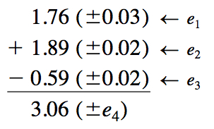
Propagation of Error Addition and Subtraction

Slide 19
Example

Slide 20
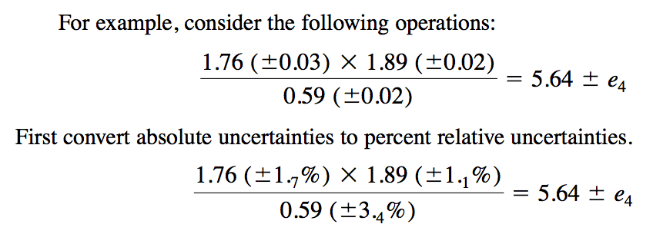
Propagation of Error Multiplication and Division

Slide 21
Example (Cont.)

Slide 22
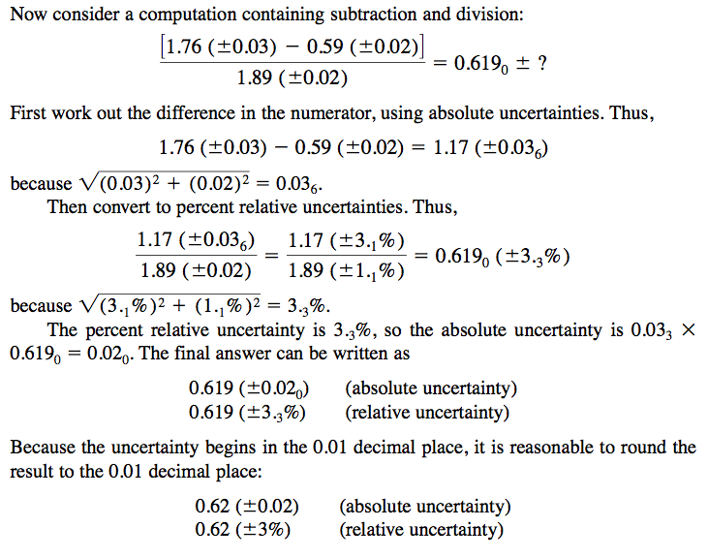
Mixed Operation

Slide 23
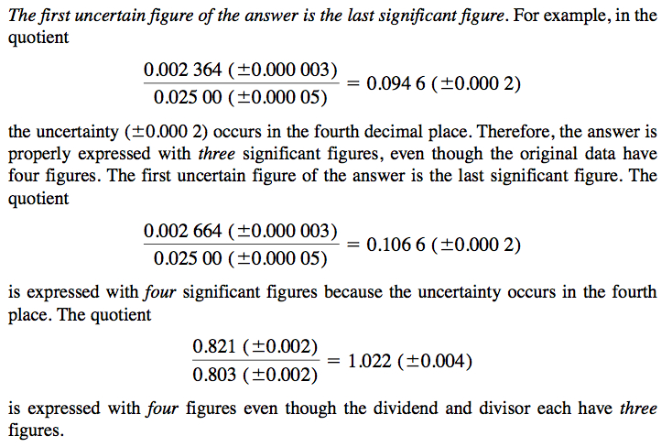
Changing significant figure

Slide 24
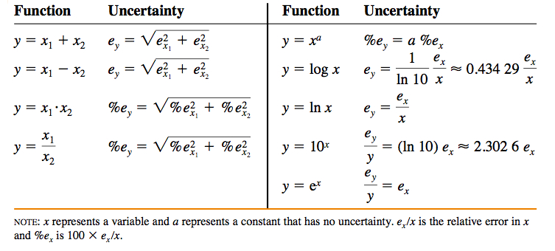
Summary

Slide 25
Exercise Significant Figures

Slide 26
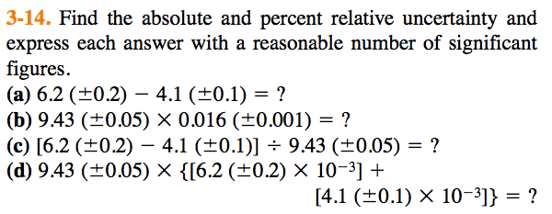
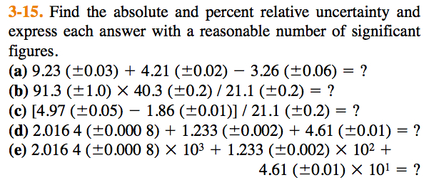
Propagation of Error

Slide 27
Credits
Most of the materials in this lecture is taken directly from:
http://chem35.files.wordpress.com/2007/11/ch03.pdf
[Unfortunately the link is no longer working.]
Download and read the chapter directly for more details.

